Slide 1
What Is An Adjustment?
A chiropractic adjustment improves
alignment and movement of the spine,
which promotes better function of
the muscles and joints,
the nerves and organs…
and, even the brain!

Slide 2


Chiropractic Lifestyle, Or
Western Medicine Lifestyle?

Slide 3
Think About Chiropractic Like This…
Healthy Spine and Nervous System
Function Better Naturally
From The Inside-Out

Slide 4
What Is An Adjustment?
A chiropractic adjustment improves
alignment and movement of the spine,
which promotes better function of
the muscles and joints,
the nerves and organs…
and, even the brain!

Slide 5

Chiropractic Improves Function
Naturally From The Inside-Out

Slide 6


Tell Your Friends…
They Need To Come See Us!

Slide 7
What Is Your Health Focus?
To merely FEEL good moment to moment, or
To FUNCTION at your best over your lifetime
Our Focus Dictates Our Future!

Slide 8
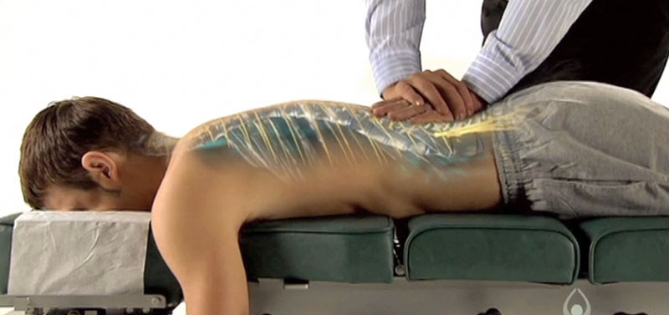
Chiropractic Improves Function
Naturally From The Inside-Out

Slide 9
Think About Chiropractic Like This…
Healthy Spine and Nervous System
Function Better Naturally
From The Inside-Out

Slide 10


Chiropractic For Lifelong Wellness
The Earlier We Start, The Better

Slide 11
Tell Your Friends…
They Need To Come See Us!

